Slide 1

Used Car Pricing Engine
Group
2

Slide 2
TEAM
Mentor: Mr.Jatinder Bedi
Team Members:
Lokesh Kumar
Bala Yudhistran B
A Pavithra
Shem Jabasteen
Harish Aaditya

Slide 3
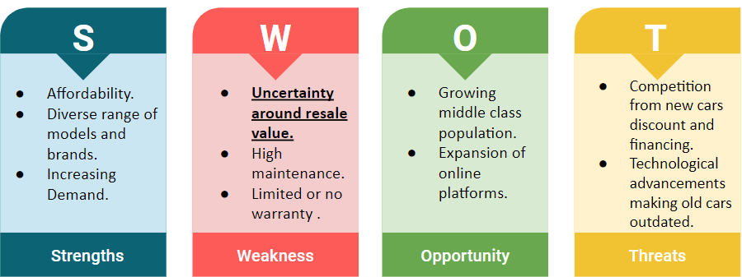
Business Understanding
CarDekho is an online platform in India for buying and selling used cars.

Slide 4

Business Problem and Suggested Solution
The biggest challenge while resale of used cars is to determine the fair market value of a used car due to factors like mileage, condition, model year, and regional variations.
Establishing a resale price that meets the expectations of both buyers and sellers while ensuring the company's profit margins remains essential for business success.
The proposed solution involves a data-driven approach that uses comprehensive analysis of key factors influencing used car resale value.
This approach utilizes machine learning model to accurately estimate prices, ensuring more informed and precise pricing decisions.

Slide 5
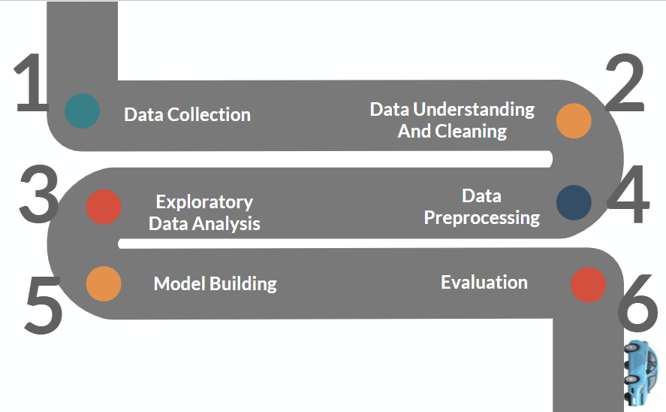
Approach

Slide 6
Data Collection
The data has been obtained from Car Dekho and was downloaded from Kaggle.
The dataset is made publicly available for research and educational purposes.
Source: https://www.kaggle.com/datasets/sukritchatterjee/used-cars-dataset cardekho?select=cars_data_clean.csv.
Number of Rows | 37813
Number of Columns | 66
Types of Columns | Numerical - 31 Categoric - 32 Boolean - 3
Target Column | Listed price

Slide 7
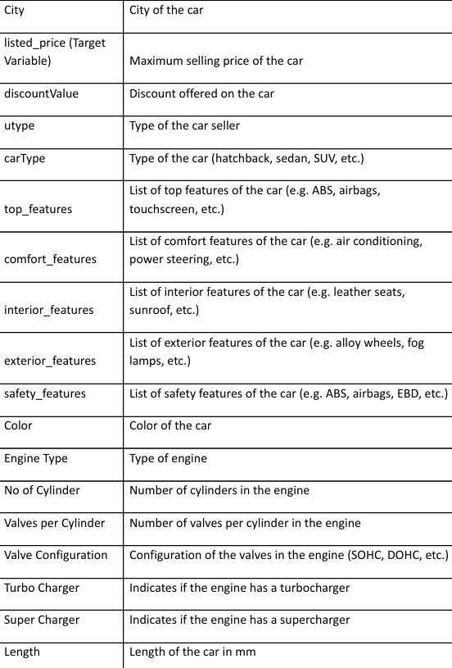
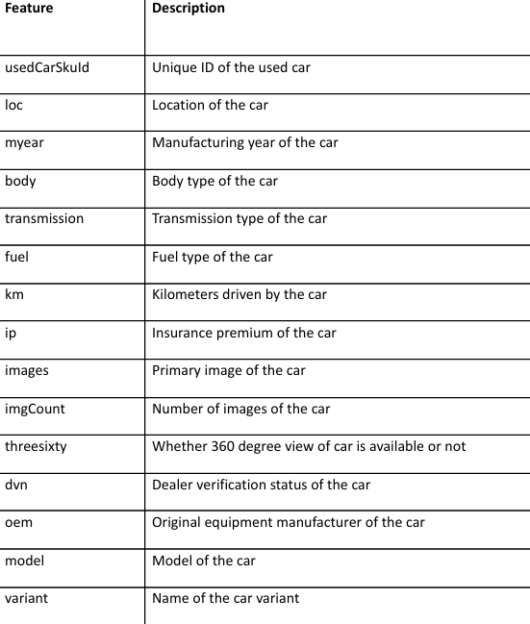
Data Description

Slide 8
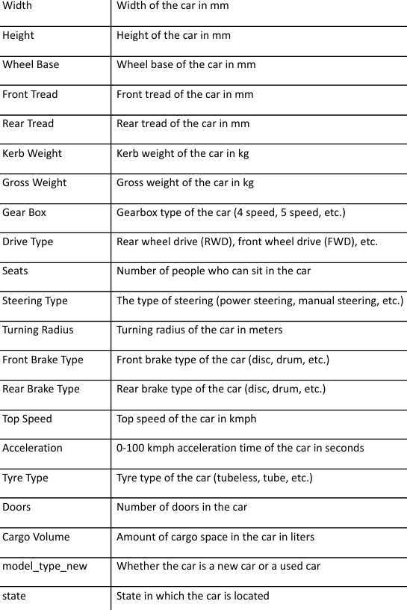
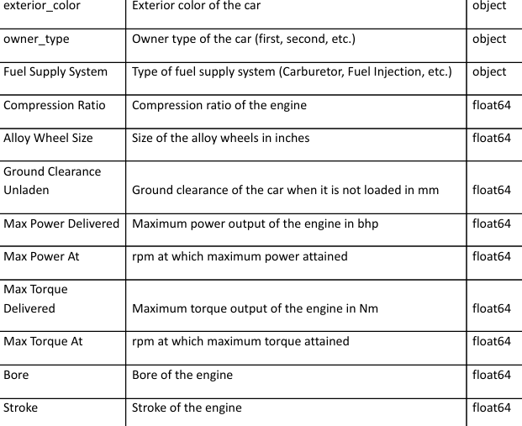
Data Description

Slide 9


Data Cleaning
 | Anomalies | Count | Approach
 | Redundant Columns | 3 columns (UserSkuId, Images, model new type) | Removed
 | Duplicates | 19 rows | Removed
 | Data Inconsistencies and other anomalies | Column values represented in two different units | Resolved
 | Missing values | 31 columns | Imputed

Slide 10
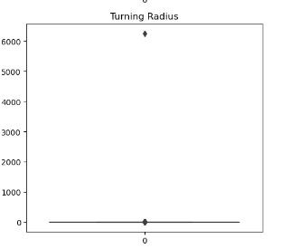
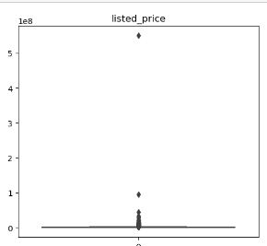
Anomalies Treated
Turning Radius -
Changed 6250 meters to 6.250 meters
Listed price -
Changed 550000555.0 rupees to 550000.555 rupees

Slide 11
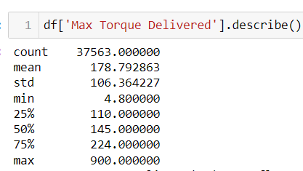
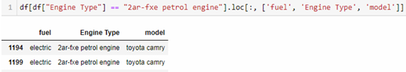
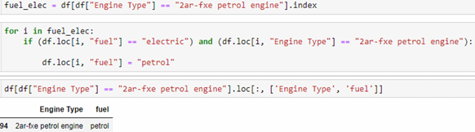
Data Inconsistencies Resolved
Max Torque Delivered -
Some values are represented in Kgm and others in Nm. Changed Kgm to Nm.
Fuel-
The cars having the engine ‘2ar-fxe petrol engine ’ were misclassified as electric instead of petrol.
Represented in Kgm
Represented in Nm

Slide 12
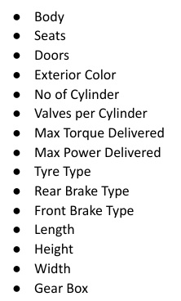
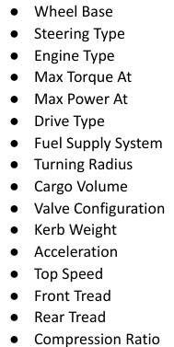
Missing Value Treatment
Imputed Columns
Nearly 31 columns had missing values.
Three columns (Bore, Stroke and Ground Clearance Unladen) with more than 60% null values were excluded from model building to prevent the risk of negatively affecting model accuracy.
The missing values in the remaining columns were imputed based on fuel category (Diesel/Petrol, CNG/LPG, Electric), body type (Hatchback, Sedan, SUV, etc.), and model (Tata, BMW, Maruti, Ford, etc.), ensuring a logical and accurate imputation process.

Slide 13
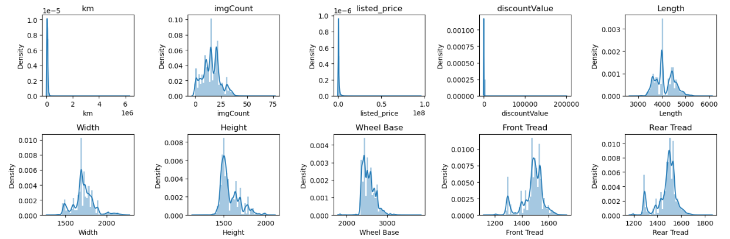
Exploratory Data Analysis
Univariate Analysis
Km, listed price, and discount value show positive skewness, indicating that most values are concentrated on the lower end with a few high outliers.
The distributions of length, width, height, front and rear tread display distinct peaks, suggesting grouping within the data.
The wheelbase for most cars falls between 2400 mm and 2700 mm.

Slide 14
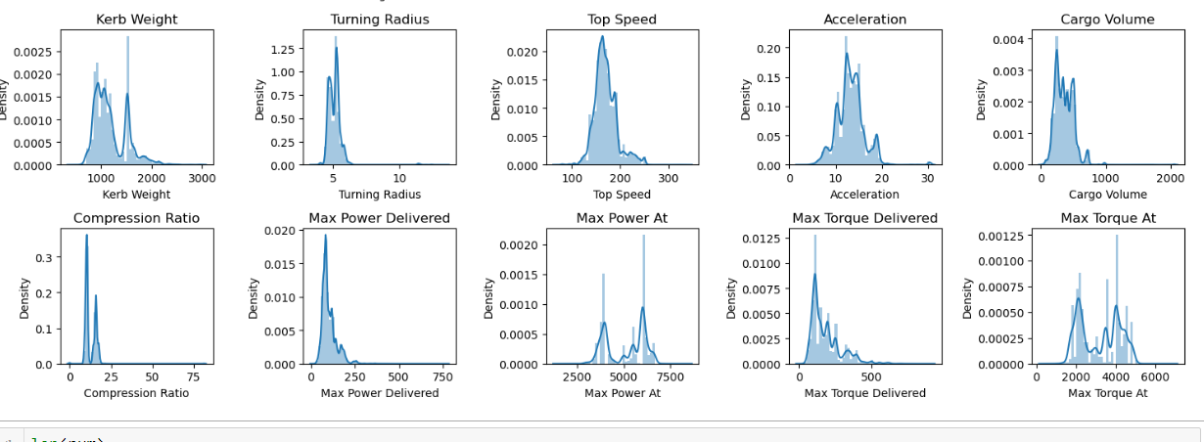
Exploratory Data Analysis
Univariate Analysis
Turning Radius, Max Power Delivered, Max Torque Delivered, Compression Ratio, Cargo Volume - Positively Skewed.
Kerb Weight, Max Power At, Max Torque At - Show distinct groups.
Acceleration and Top Speed - moderately positively skewed.

Slide 15
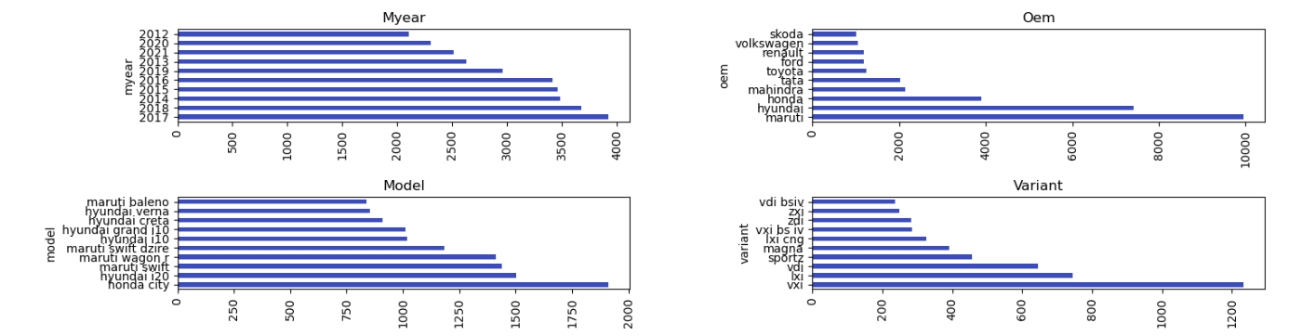
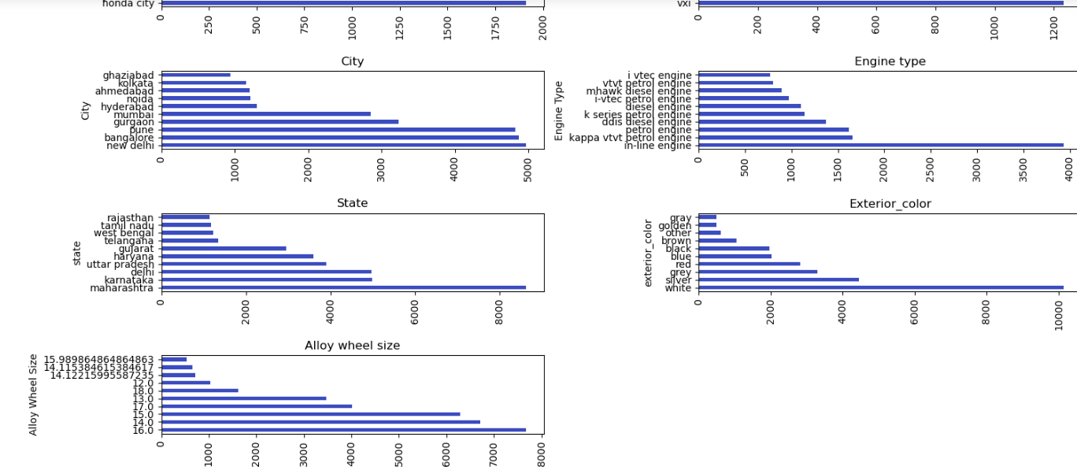
Exploratory Data Analysis
Univariate Analysis
Most available cars are 2017 manufactured.
Most preferred car company is Maruti.
Most preferred car model is honda city.
Most preferred variant is Maruti Swift VXI.
Most used cars are from New Delhi, Bangalore and Pune.
Inline Engines are most common in non-evs.
Maharashtra tops in used cars source.
White cars are most common among the used ones.
Most cars have alloy wheel size of the cars of 16 inches.

Slide 16
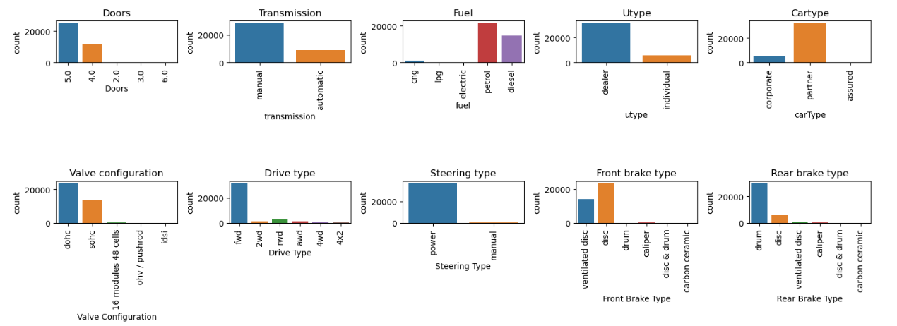
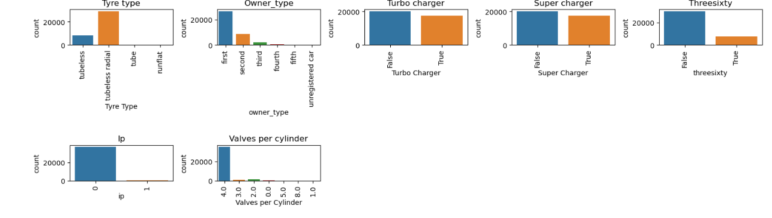
Exploratory Data Analysis
Univariate Analysis
Most cars have 5 doors.
Manual transmission cars is the most common type available.
Petrol followed by Diesel cars are preferred more.
Most used cars are from dealers.
Dohc is the most available valve configuration.
Most used cars have Fwd.
Power steering are more common.
Most used cars have Disc and Drum brakes.
Most Tyres are Tubeless radial.
Turbo and Supercharger are not available in most cars.
Most used cars listed have a 360 view of the car displayed.
Only very few cars come with insurance premium.
Most cars with ICE have 4 valves per cylinder.

Slide 17
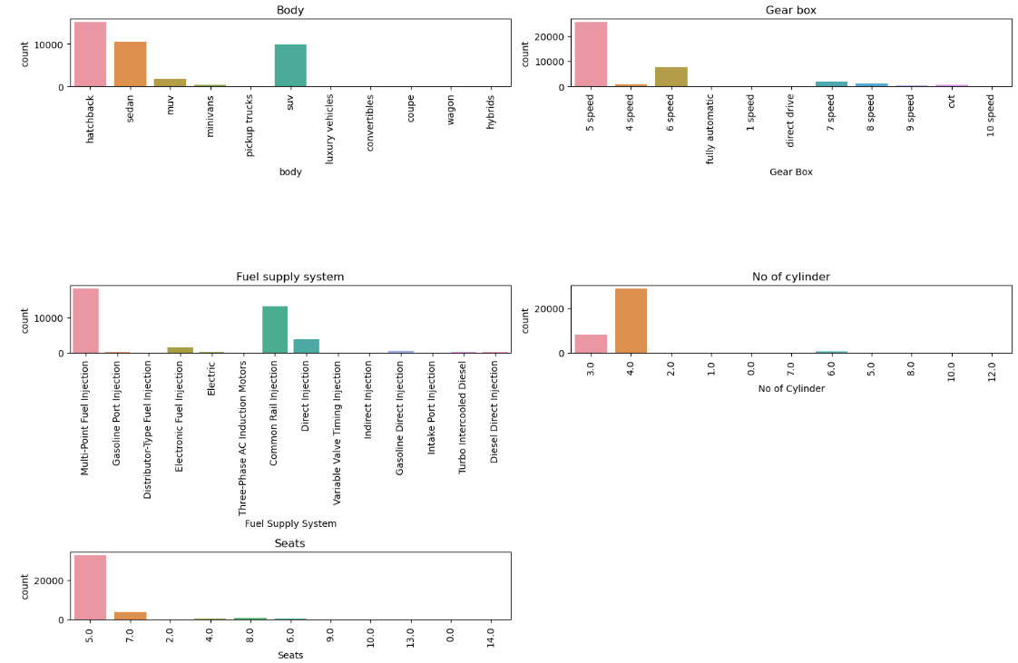
Exploratory Data Analysis
Univariate Analysis
Hatchback, Sedan and SUV are the three body types with which the used cars are available.
Most cars have 5 speed gearbox.
Most non-electric cars have multi point fuel injection system and 4 cylinders.
Cars with 5 seats are most available.

Slide 18
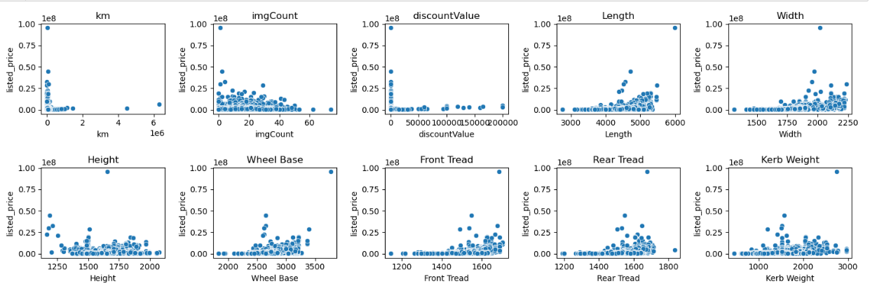
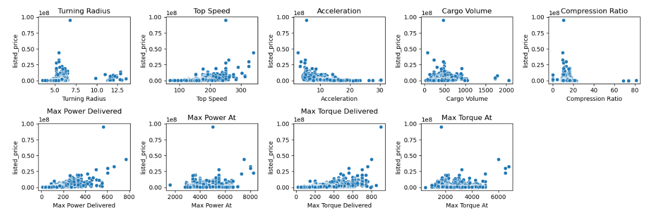
Exploratory Data Analysis
Bivariate Analysis
A weak positive correlation can be seen between listed price and :
Length,
Width,
Wheel base,
Front and Rear Tread
Kerb Weight,
Top Speed,
Max Power Delivered, and
Max Torque Delivered
A weak negative correlation can be seen between listed price and Acceleration.

Slide 19
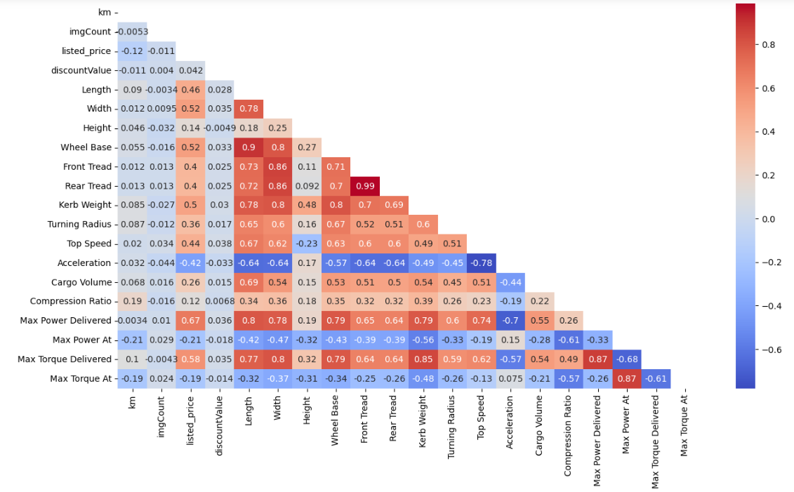
Correlation Plot
The correlation plot shows multicollinearity among the independent variables.
Strong Positive Correlation is observed among variables length, Width, Wheelbase, Front and Rear Tread, Kerb Weight etc
Strong Negative Correlation is between Acceleration Vs
Top Speed
Max Power and Torque Delivered
Compression Ratio and
Max Torque At
Max Power At also show negative correlation.

Slide 20
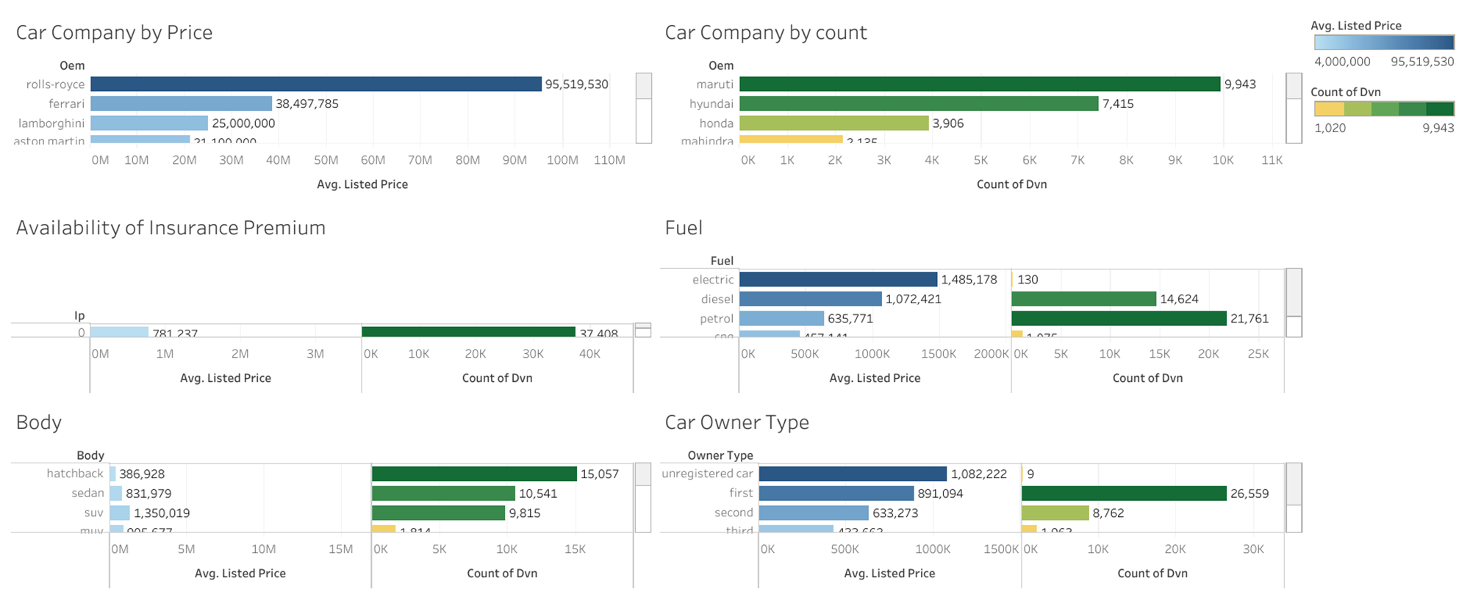
Bivariate Analysis

Slide 21
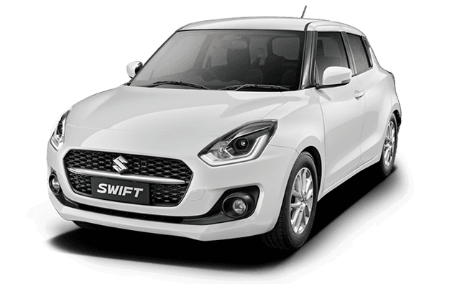

Business Insights
Most Common / Preferred Vehicle Characteristics
Exterior
5 to 15 years age
Oem: Maruti
Variant: VXI
Body: Hatchback
Doors: 5
Tyre: Tubeless Radial
Color: White
Fuel: Petrol

Slide 22
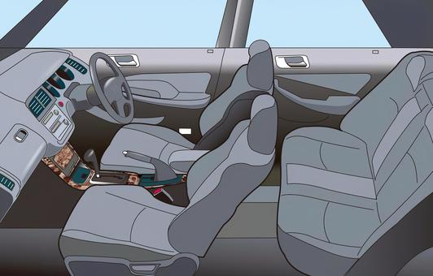
Business Insights
Most Common / Preferred Vehicle Characteristics
Interior
Power Steering
Gear Box: 5 speed
Transmission: Manual
Seats: 5
Top Features:
Cd Player
AC
Heater
Central Locking
Anti-Lock braking system
Adjustable Headlights

Slide 23
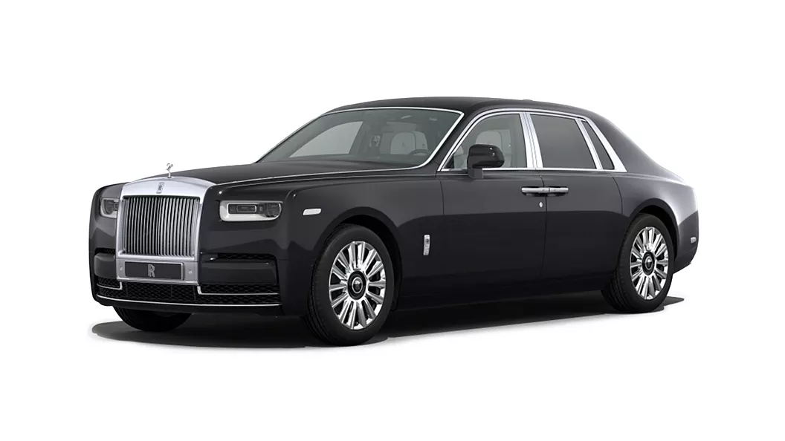
Business Insights
Pricing Analysis
The most Priced
1 year age
Body: Coupe
Model: Rolls Royce Phantom
Doors: 2
Color: Black
Tyre: Runflat
Fuel: Electric
Steering: Power
Insurance Premium: Available
Turbo and SuperCharger: Available
Front and Rear brake: Carbon Ceramic
Drive Type: awd

Slide 24
Business Insights
Regional Variation
Maharashtra, Karnataka, and Delhi lead in the number of used car purchases.
The average price of used cars is higher in Odisha, Tamil Nadu, and Delhi.
In Tamil Nadu, Chennai and Coimbatore are the top cities for used car purchases.
Bhubaneshwar is the leading city for used car purchases in Odisha.
Pune ranks first in used car purchases in Maharashtra, followed closely by Mumbai.

Slide 25
Statistical Tests
To establish the dependency between variables for further steps, statistical tests were performed.
Check for normality and equality of variance - Jarque-Bera, Levene’s
Data - Not normal - Transformation - Still not normal
Non-Parametric Tests: i. Mann-Whitney U Test ii. Chi-Squared Test

Slide 26
Data Preprocessing
Outliers Handling: IQR used for identifying the outliers within the dataset reveals nearly 3070 outliers. For upper and lower whiskers, 2.5*IQR is considered as the dataset is highly skewed and a substantial amount of data would fall into outliers. The outliers in the dataset were retained because they represent valuable information, particularly high-priced car models that are critical for analysis.
Label Encoding: The categorical columns are label encoded as there is no hierarchy but the cardinality of the categorical columns are higher.
Data Partitioning: The data is split into train and test sets. The model is built on the train dataset. The test dataset is used to evaluate the model.
Robust Scaling: Robust scaling is done to scale the columns because of the presence of outliers and the distribution of the data is not normal.

Slide 27
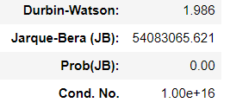
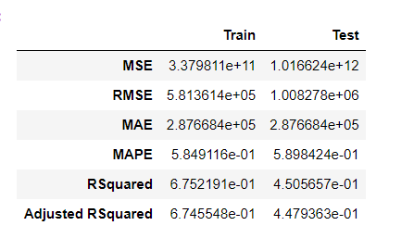
Base Model: Linear Regression (OLS)
DW is around 2: No Autocorrelation
JB p value<0.05, Data is not normally distributed
Cond No: very high- Multicollinearity in the data
MAPE for train and test data is around 0.58 - high, indicating there is more scope for improvement.
Adjusted R Squared: Drop in test data indicating the model might be overfitting.

Slide 28
Feature Engineering
New Feature | Derivation
Car Age | Current year - myear
Feature Count | Count of the features were taken from top, internal, external, safety and comfort features given as list
Kilometers per year | km/car age
Acceleration Power Ratio | Ratio between the time for acceleration from 0-100 and the Maximum Power Delivered
Speed Weight Ratio | Ratio between Top speed and Kerb Weight
Turning Efficiency | Ratio between the Turning Radius and Car Length
Power Torque Ratio | Max Power Delivered/ Max Torque Delivered

Slide 29
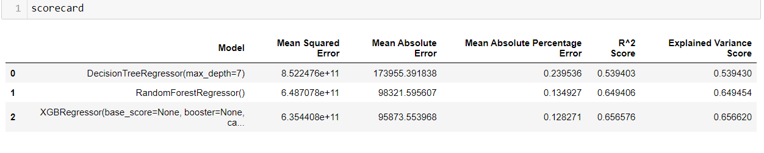
Comparing Different Models
Based on the metrics XGB Regressor is chosen as the best model. It has the lowest MSE, MAE, and MAPE, and the highest R2 score. This suggests that it provides the most accurate predictions and explains the most variance in the target variable when compared to the other ones.

Slide 30
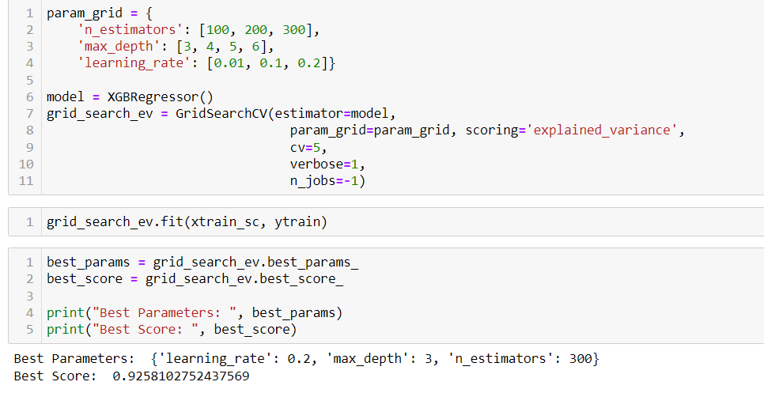
Hyper Parameter Tuning

Slide 31
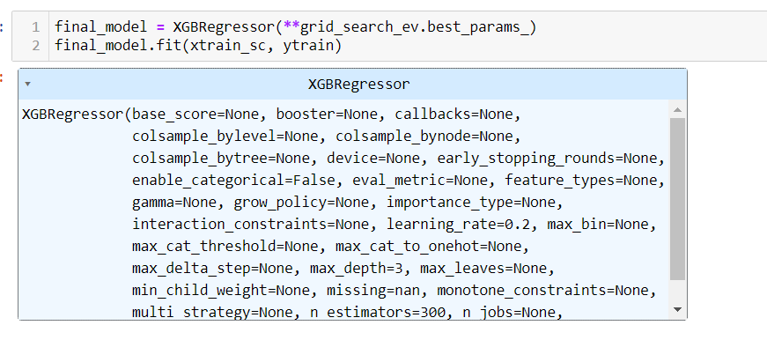
Final Model

Slide 32
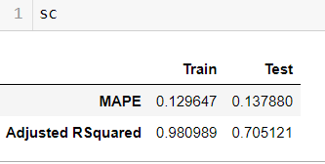
Conclusions
The final model has achieved a lower MAPE, indicating an improvement in accuracy.
The R² score has significantly improved, increasing from 65% to 98%.
However, the model shows signs of overfitting and may not generalize well to unseen data.
A major challenge with the dataset is the large number of columns, with about half requiring extensive data cleaning.
Proper feature selection and encoding techniques can help reduce overfitting and improve the model’s performance.

Slide 33
Limitations
Impact of New Technologies: Rapid advancements like electric vehicles and autonomous driving can influence used car values, but data scarcity limits accurate predictions.
Ignoring Depreciation: Used car values depreciate nonlinearly based on factors like mileage and condition, which must be considered to avoid inaccurate predictions.
Interest Rate Influence: Changes in interest rates affect the affordability and demand for used cars, impacting their market prices.
Data Limitations: Regression models may lack generalizability and can produce biased results if the training data isn't representative of broader market conditions.

Slide 34

Learnings
The dataset should be more relevant and not overly historical.
Be prepared for extensive data cleaning !
Perform feature selection when dealing with high-dimensionality.
Implement better outlier handling methods.
Always start early !

Slide 35

THANK YOU !

